Slide 1

Global Monitoring of Inland Surface Water Dynamics using Remote Sensing Data
Anuj Karpatne
University of Minnesota

Slide 2
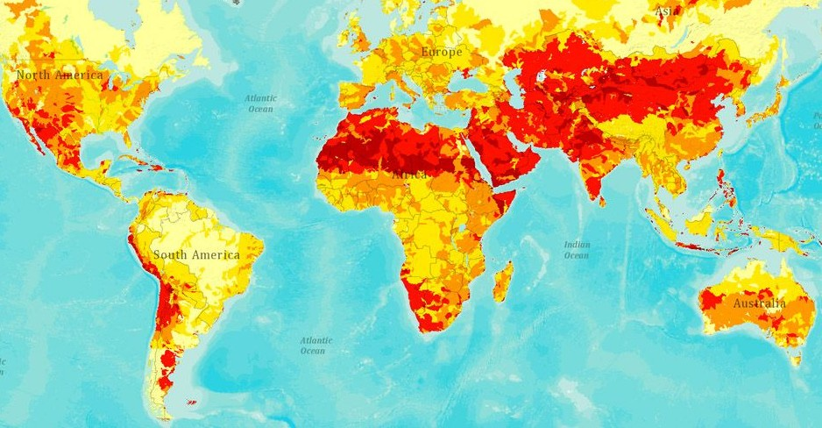
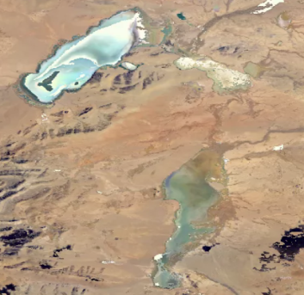
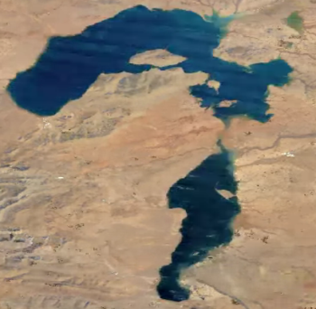
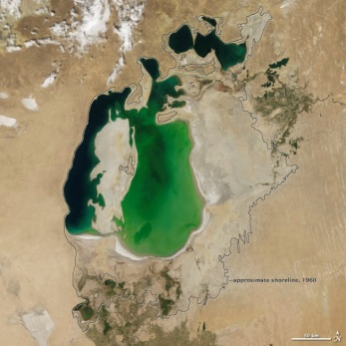
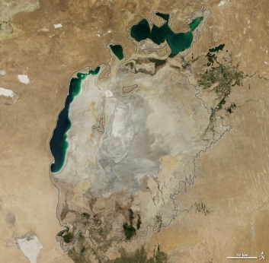
Importance of Monitoring Water Dynamics
Cedo Caka Lake
in Tibet, 2011
Cedo Caka Lake
in Tibet, 1984
Global projections of water risks (red)
Understanding interplay with
climate change
Managing water resources
Remote Sensing Data
Multi-spectral data
  MODIS (at 500m, from 2000)
  Landsat (at 30m, from 1970s)
Can be used to classify every location at a given time as water or land (binary classes)
Ground truth on specific dates available from various sources: SRTM, GLWD
Aral Sea in 2000
Aral Sea in 2014
Aral Sea in 2000
Aral Sea in 2014
Assessing the impact of human actions

Slide 3
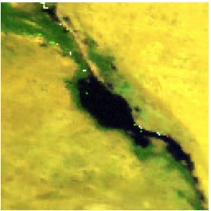
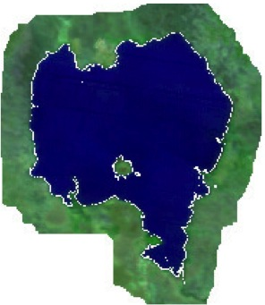
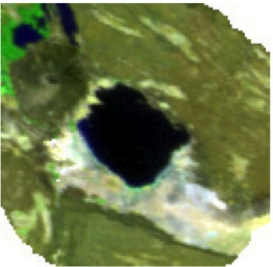

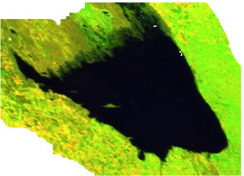
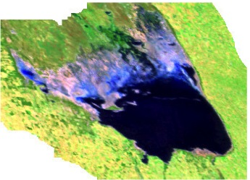
Challenges for Supervised Learning Methods
Challenge 1: Heterogeneity in space and time
  Water and land bodies look different in different regions of the world
  Same water body can look different at different time-instances
Challenge 2: Data Quality
  Noise: clouds, shadows, atmospheric disturbances
  Missing data
Great Bitter Lake, Egypt
Lake Tana, Ethiopia
Lake Abbe, Africa
Poyang Lake, China
Mar Chiquita Lake, Argentina in 2000 (left) and 2012 (right)
(Pink color shows missing data)

Slide 4
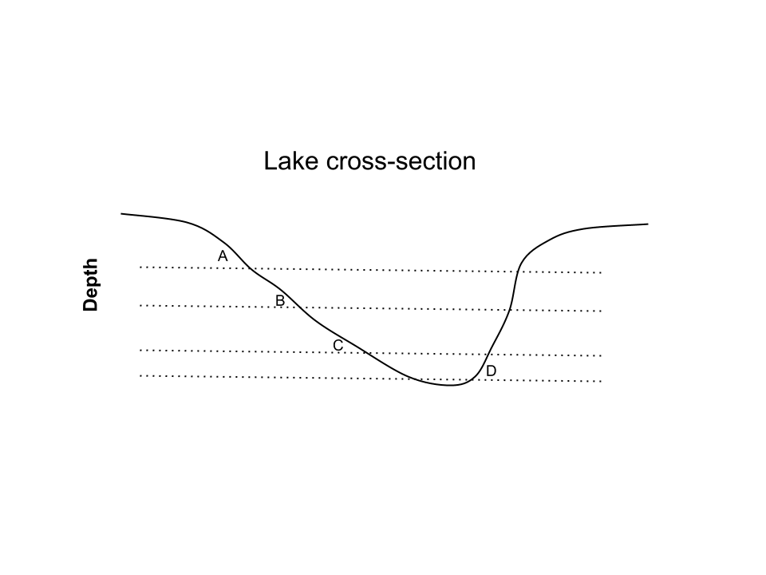
Method Innovations for Monitoring Water
Ensemble Learning Methods for Handling Heterogeneity in Data ^{1,2}
Using Physics Guided Labeling to Handle Poor Data Quality
Learn an ensemble of classifiers to distinguish b/w different pairs of positive and negative modes
Use elevation information to constrain physically-consistent labels
Positive Modes
(Water)
Negative Modes
(Land)
P₁
N₁
P₂
N₂
P₃
N₃
Elevation A > B > C > D
¹ Karpatne et al. SDM 2015
² Karpatne et al. ICDM 2015 (submitted)
Khandelwal et al. (in preparation)
Mithal et al. (in preparation)

Slide 5
A Global Water Monitoring System http://z.umn.edu/monitoringwater
Summary of Capabilities:
  Maps the dynamics of all major water bodies (surface area > 2.5 km²) in the last 15 years across the world
    Identifies on-going droughts in Brazil and California
  Finds changes in river morphology (river meandering, delta erosion)
  Detects the construction of new dams and reservoirs

Slide 6
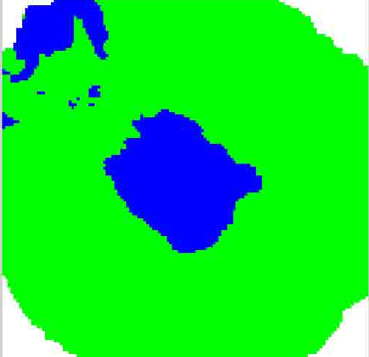
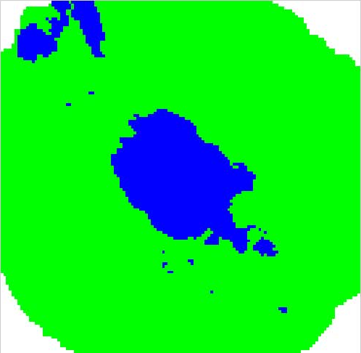
Creating Global Maps of Water Bodies
Stacks of Classification Maps over Time
Blue = Water
Green = Land
Time (from 2000 to present)
For every pixel (at 500m), compute % of times it is labeled as water across all 15 years (ignoring missing values)
Find water bodies as spatially contiguous groups of (at least 10) pixels with high % of water time-steps

Slide 7
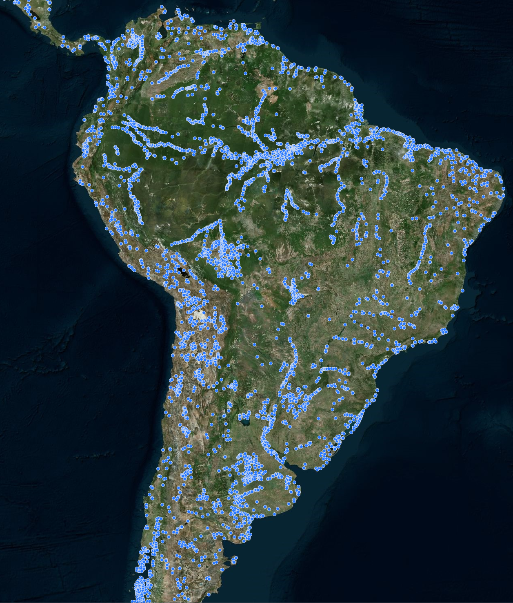
Global Maps of Water Bodies
Every blue dot is a water body, present in the last 15 years,
with size greater than 2.5 km²

Slide 8
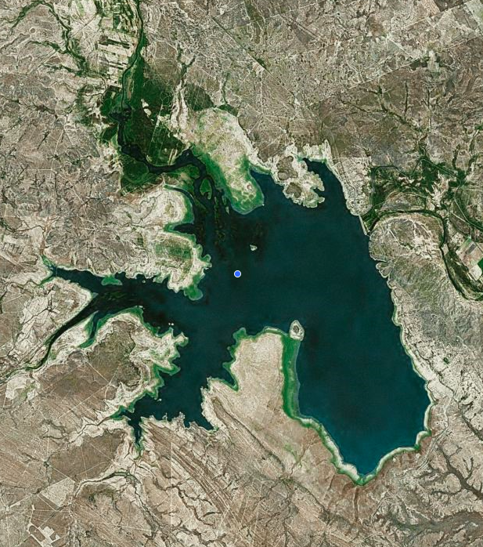
Showing Surface Water Dynamics
Summarizing Changes in Time Series:
Change Score (t) = Y_{after}(t) – Y_{before}(t)
Yearly mean before t
t
Yearly mean after t
Don Martin Dam, Mexico

Slide 9
Capturing Dynamics of Water Bodies

Slide 10
Capturing Dynamics of Water Bodies
Increase Score = Sum of Positive Change Scores / T
Decrease Score = Sum of Negative Change Scores / T

Slide 11
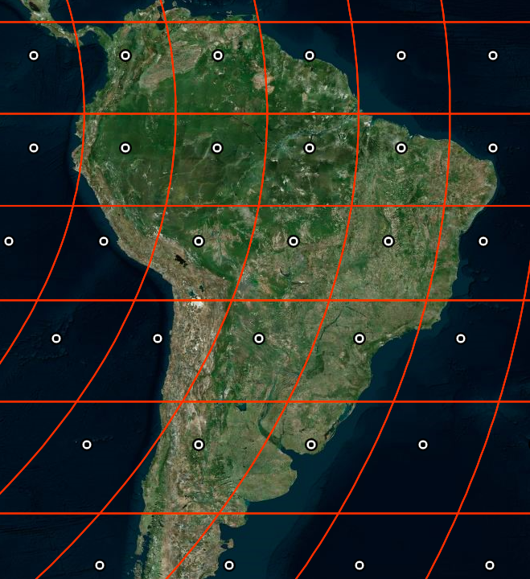
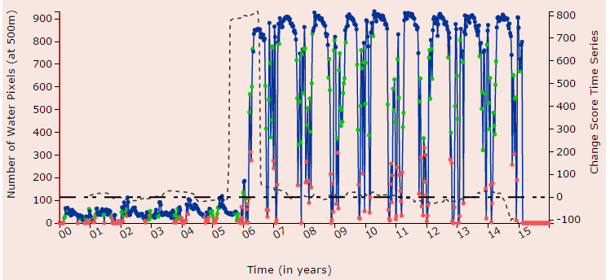
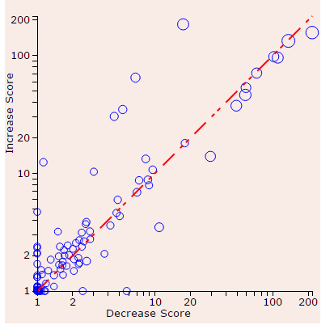
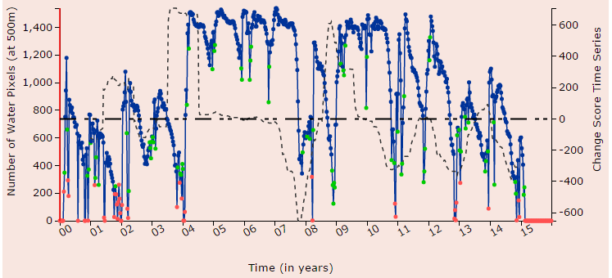
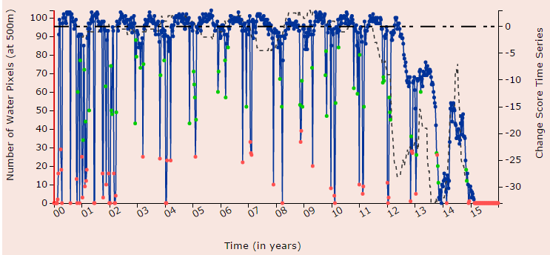
Summarizing Water Dynamics
Scoring increase and decreases over the last 15 years

Slide 12
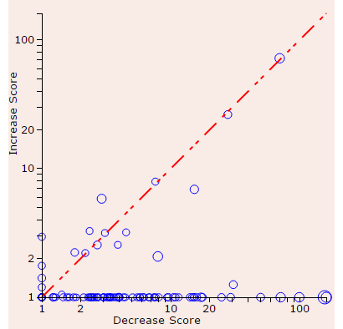
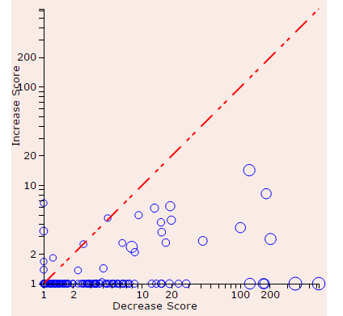
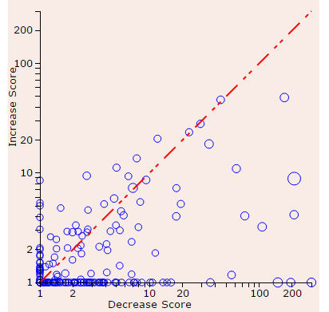
Analyzing Brazil Droughts since 2012
Computing Increase and Decrease scores only in the last 3 years

Slide 13
Finding Regions of Change
Locations that have changed from land to water or water to land in the last 15 years
Time
Compute % water time-steps in the first 3 years (2000 to 2002)
WF_{before}
Compute % water time-steps in the last 3 years (2012 to 2014)
WF_{after}
WF_{difference} = WF_{after} – WF_{before}
WF_{difference} > 0 (Water Gain)
WF_{difference} < 0 (Water Loss)

Slide 14
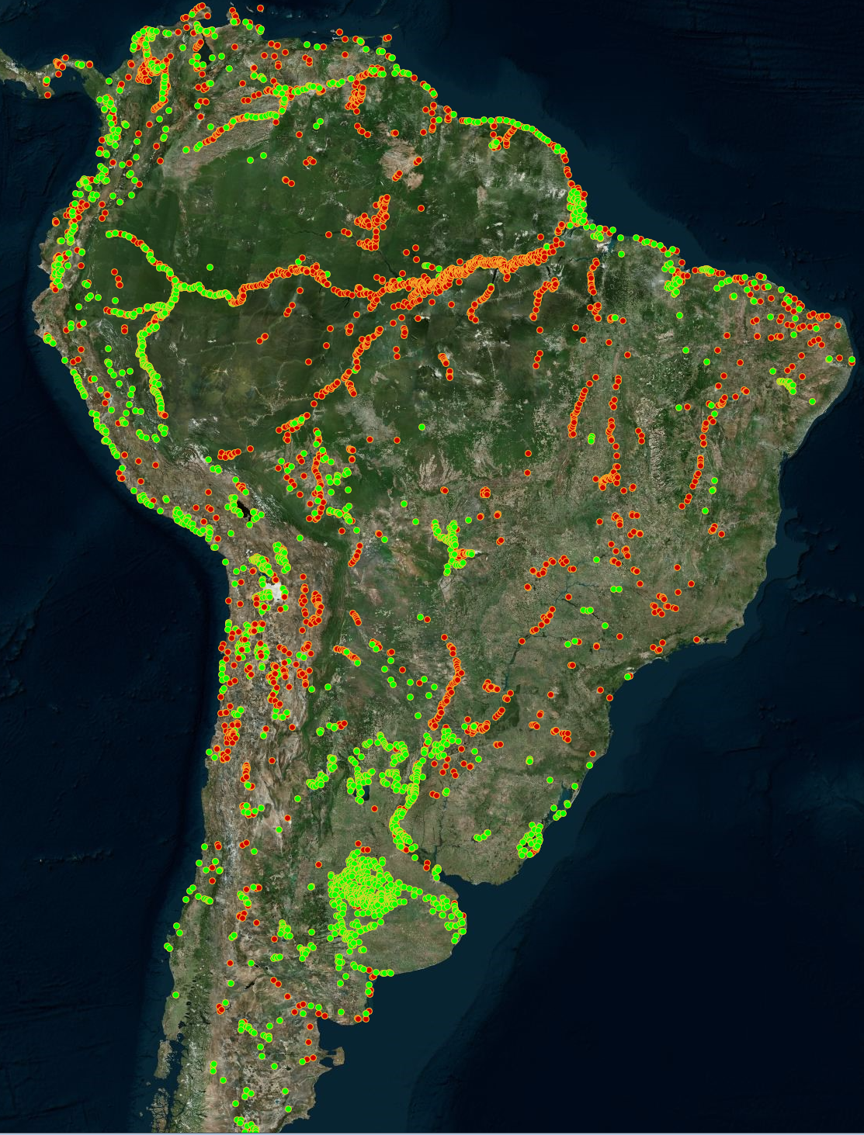
Regions of Change in South America
Every red dot is a region of size > 2.5 km² that has changed from land to water (Water Gain)
Every green dot is a region of size > 2.5 km² that has changed from water to land (Water Loss)

Slide 15
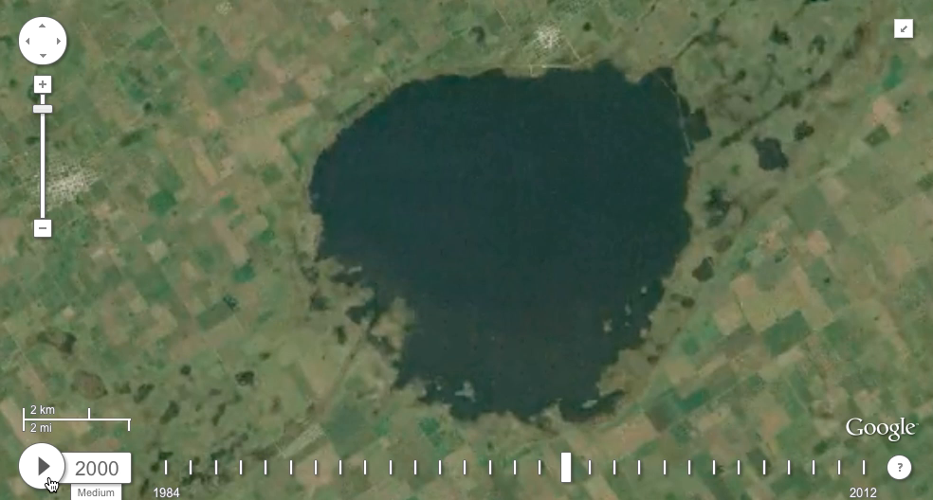
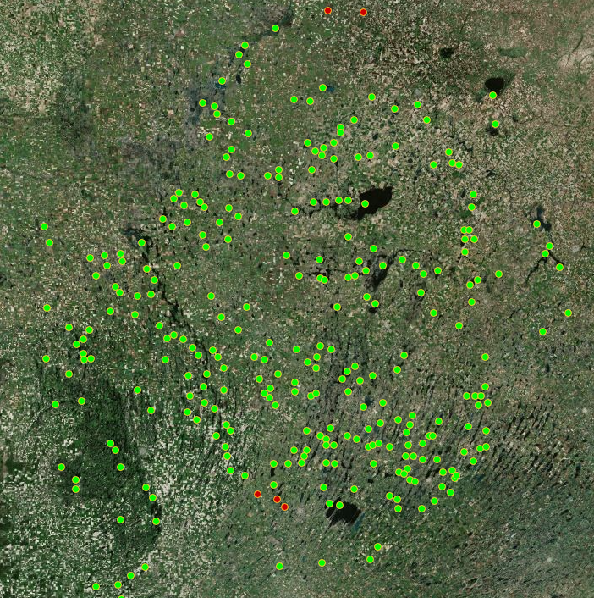
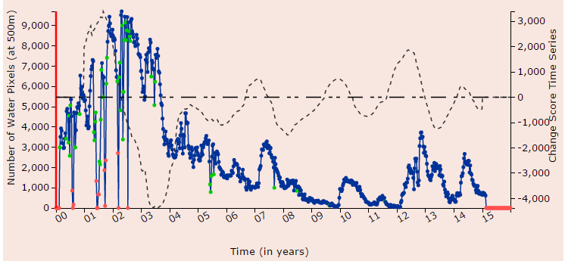
Examples of Change: Shrinking Water Bodies
Aggregate Surface Area Dynamics of this entire region

Slide 16
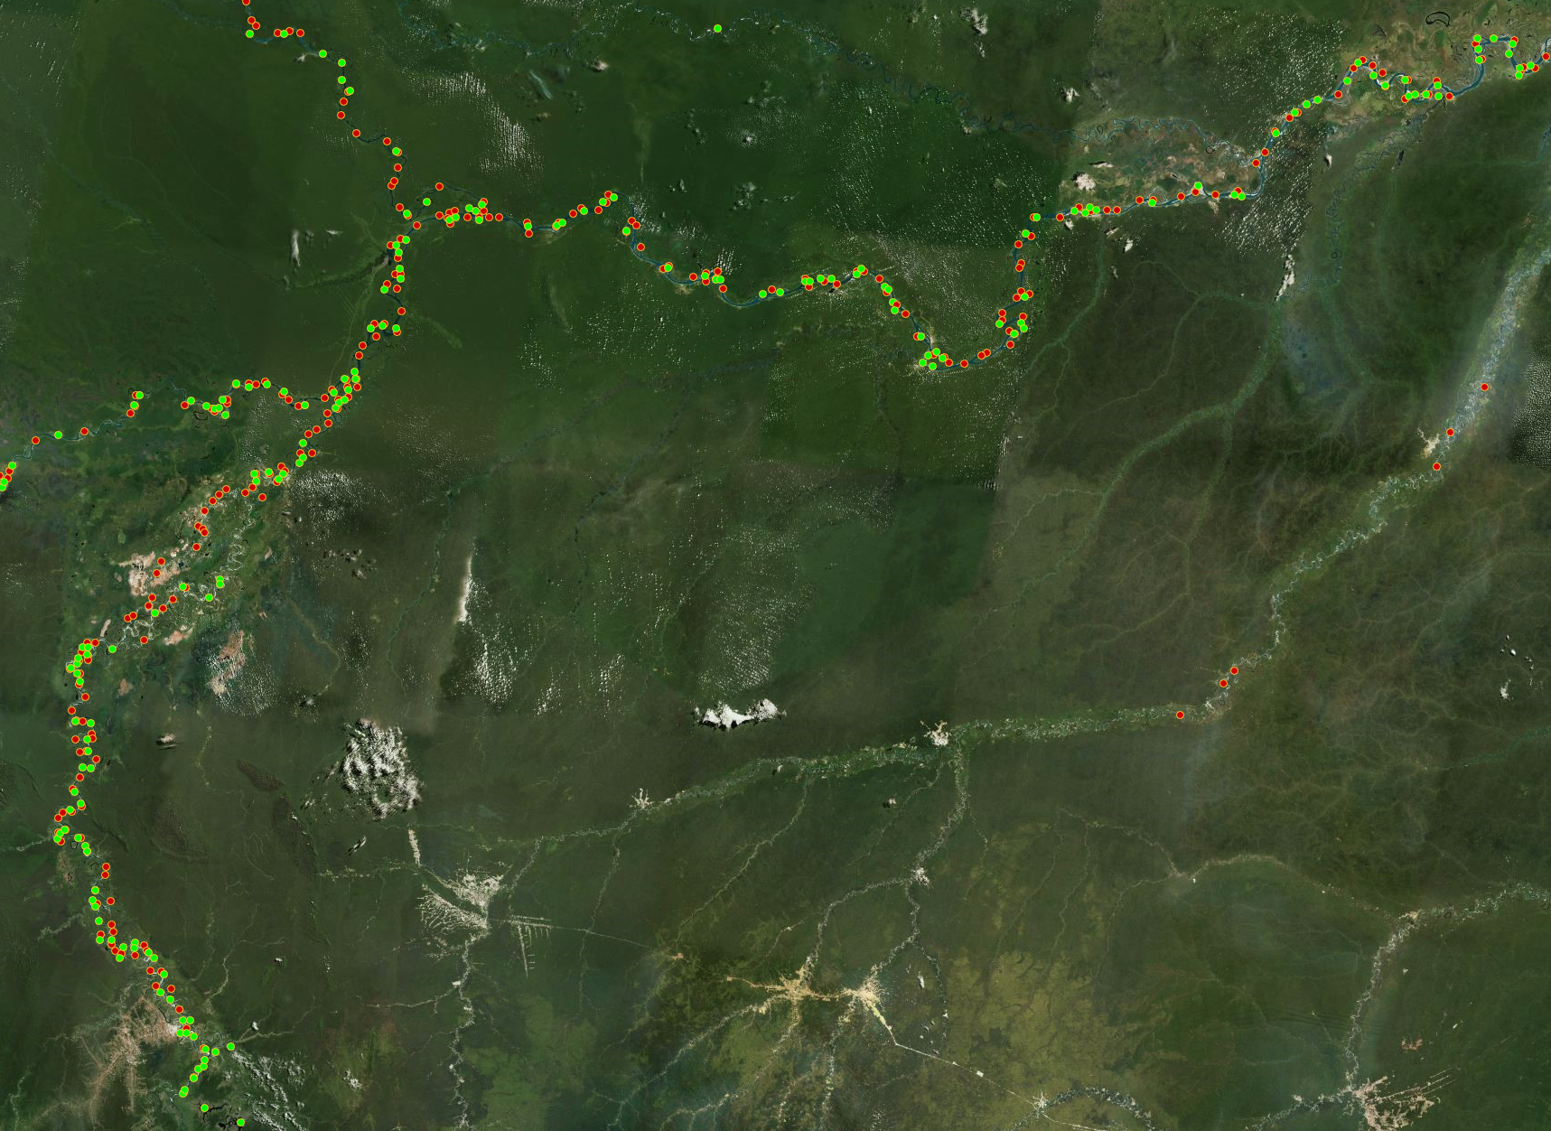
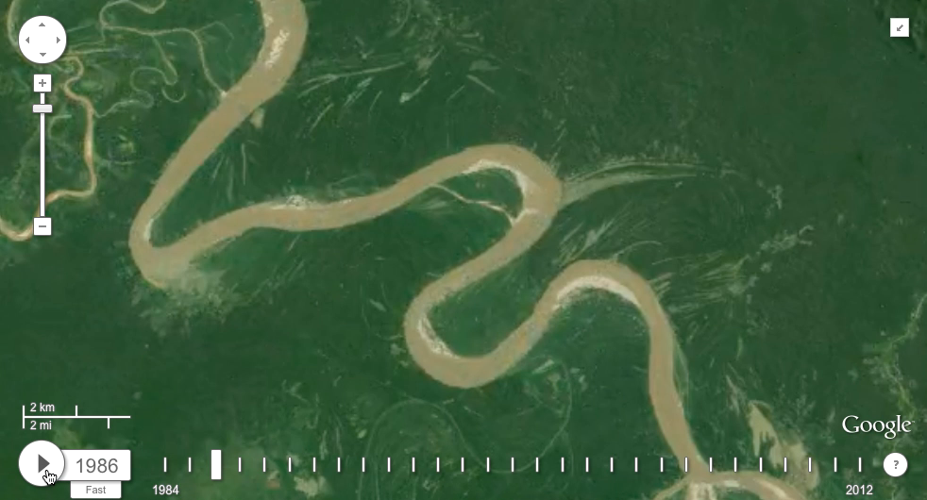
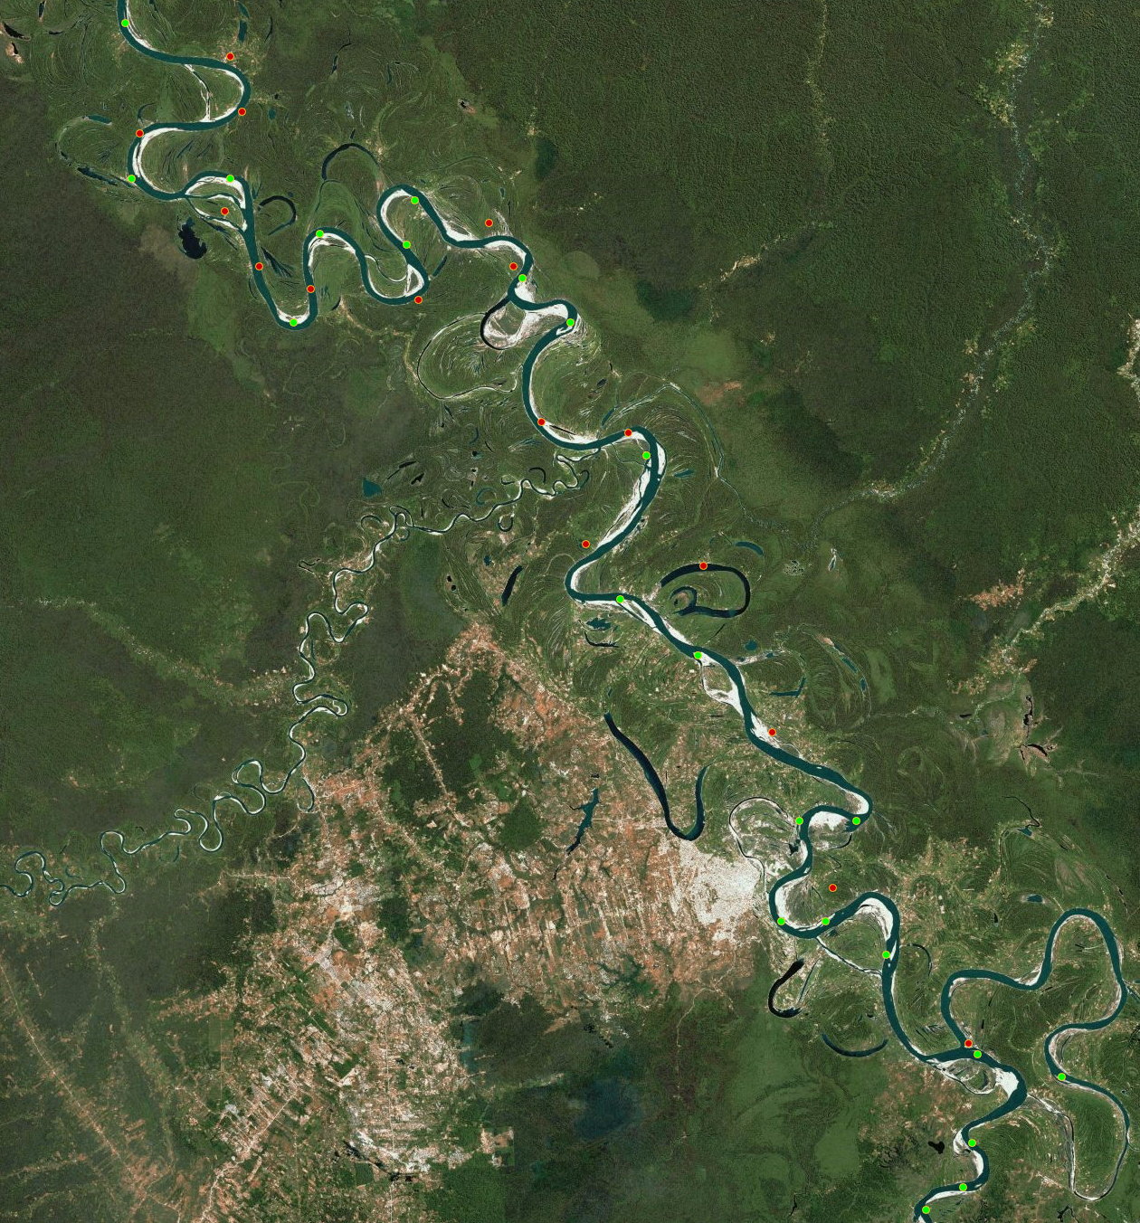
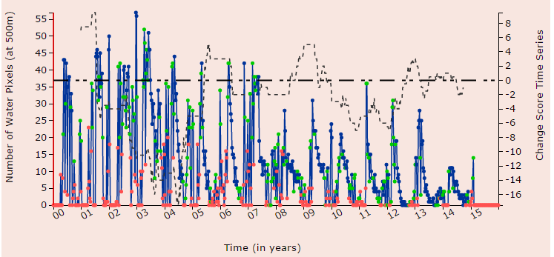
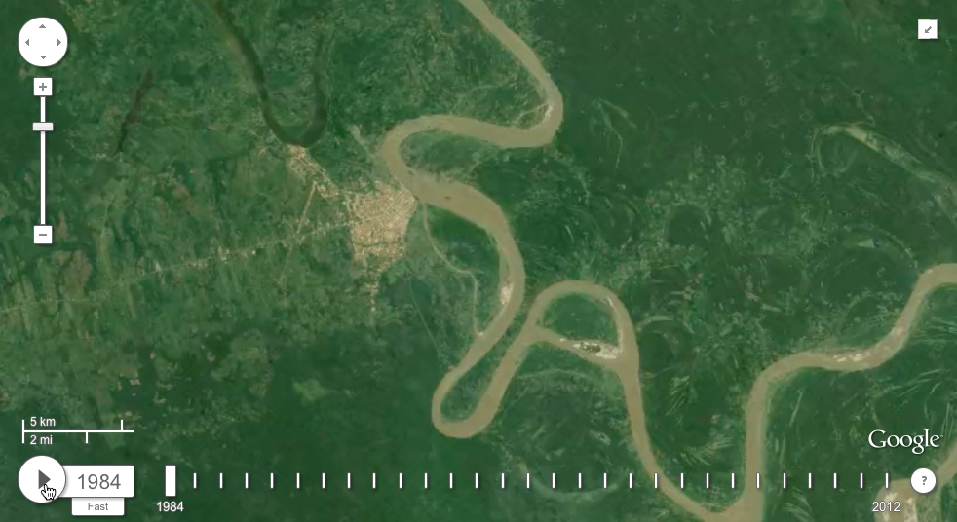
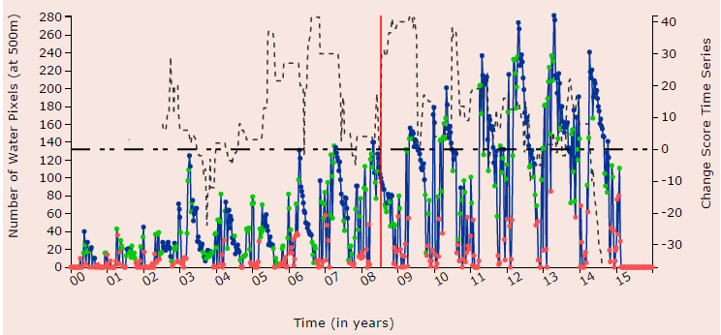
Examples of Change: River Meandering

Slide 17
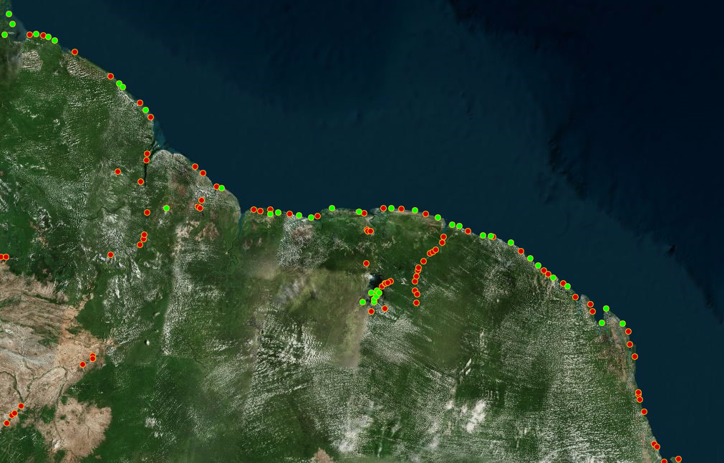
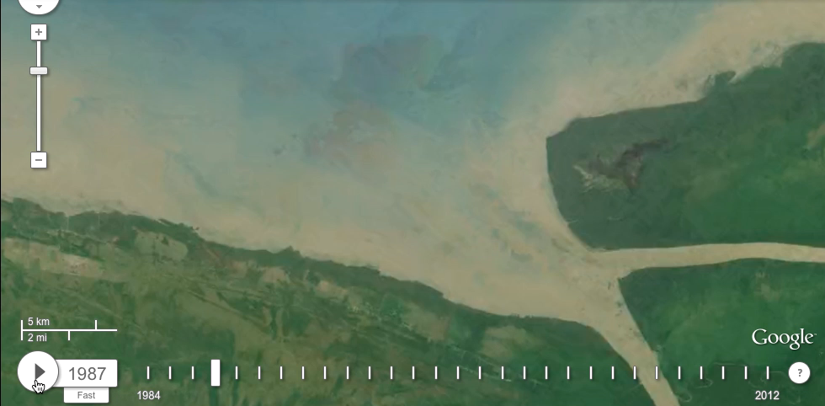
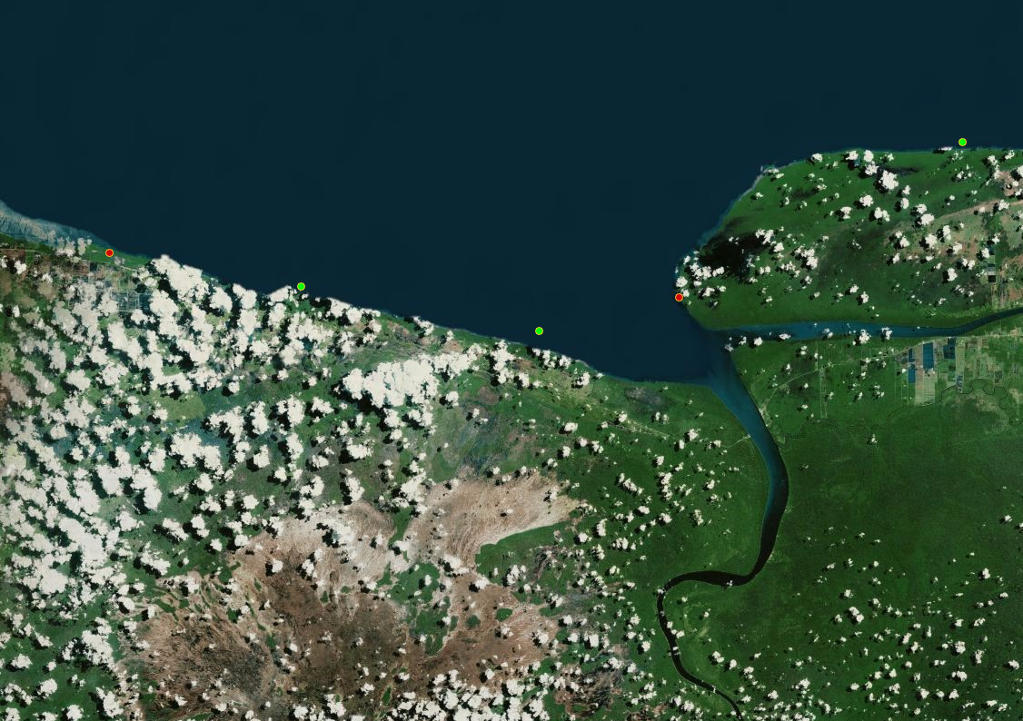
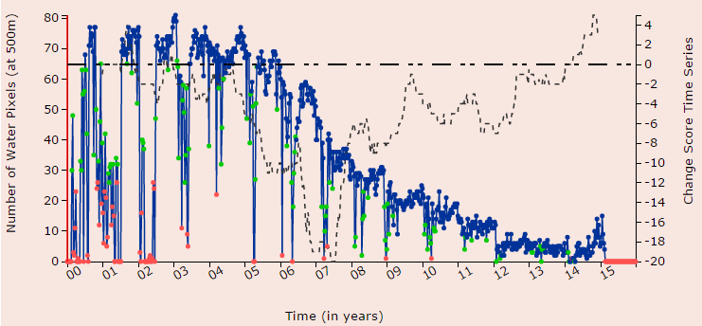
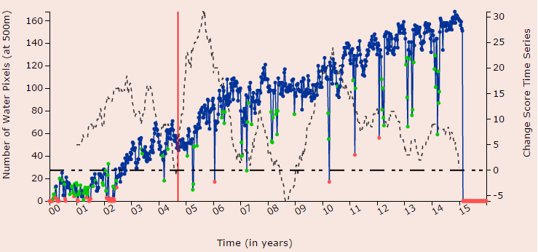
Examples of Change: Delta Erosion

Slide 18
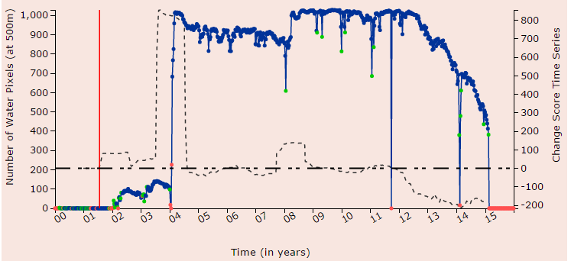
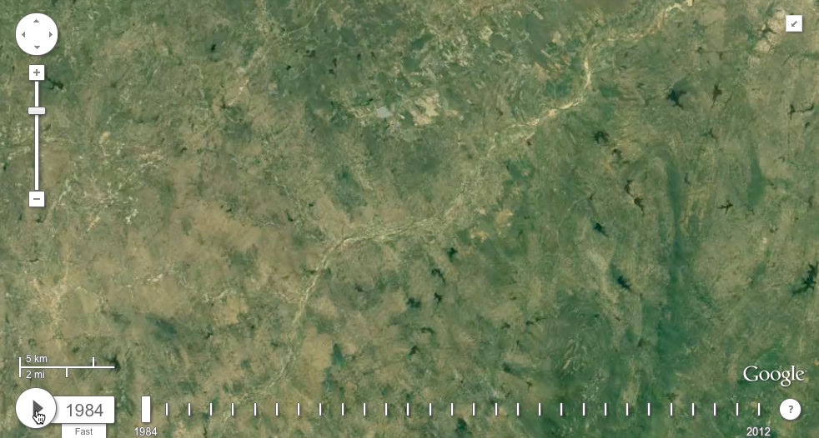
Examples of Change: Dam Constructions
Construction of a dam often results in the creation of a reservoir
Characterized by a sudden and persistent increase in surface area
Define a Sudden Increase Score to distinguish dam construction events from other natural events (gradual increases)

Slide 19
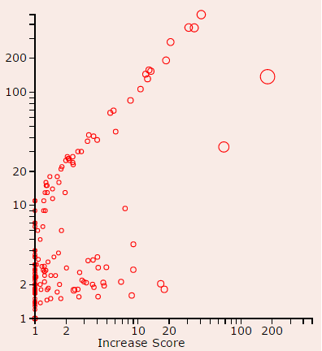

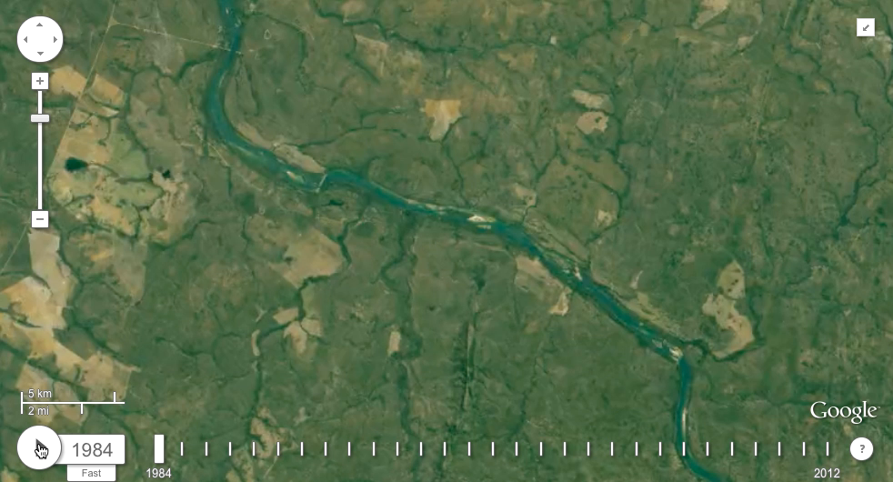
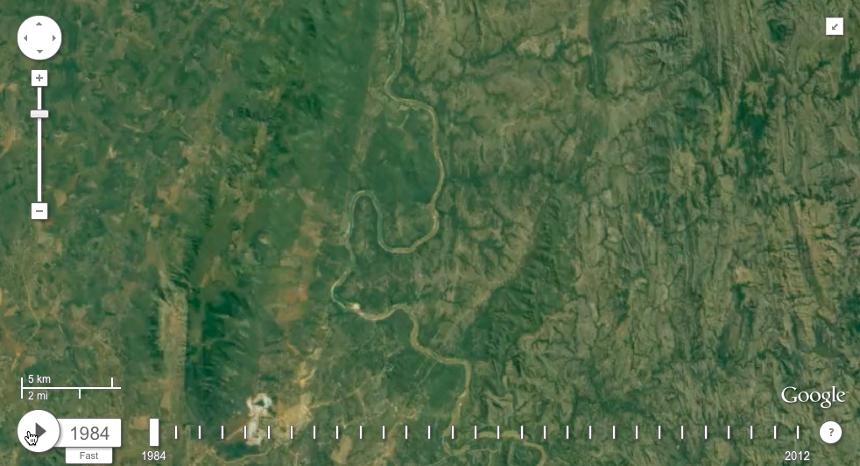
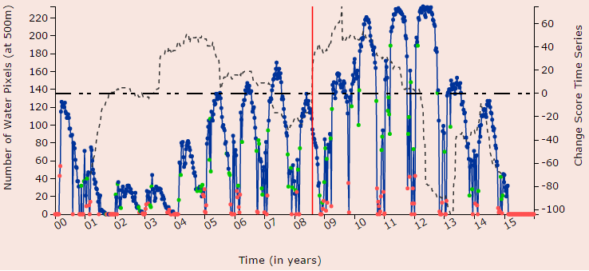
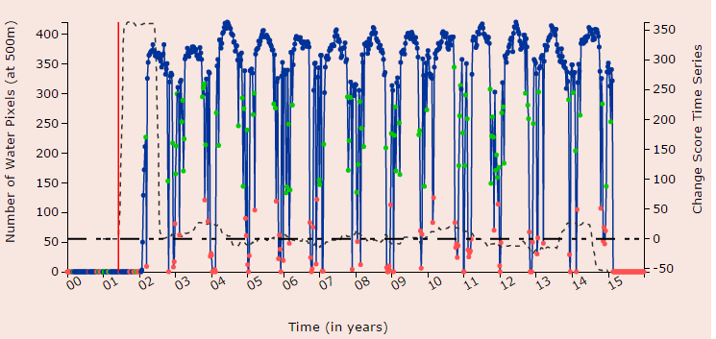
Detection of Newly Constructed Dams
1
1
2
3
3
2

Slide 20
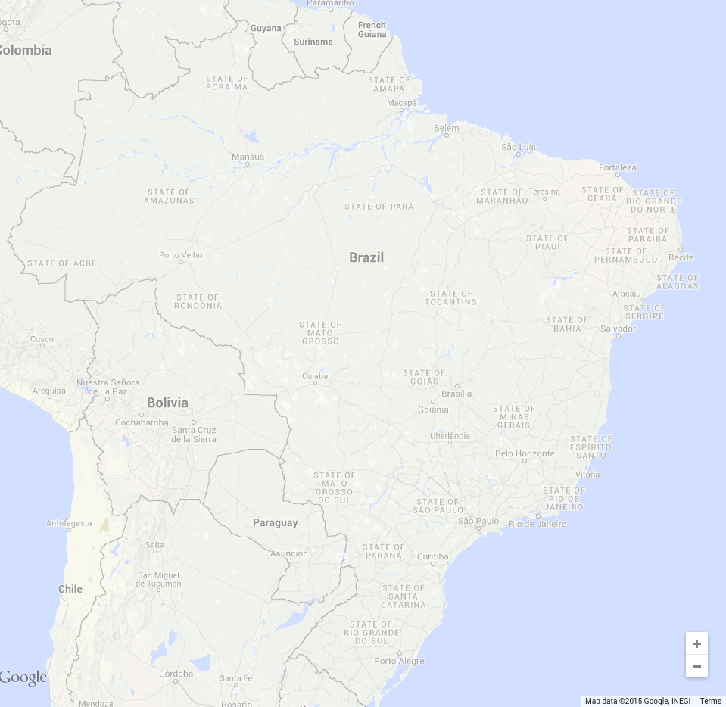
Validating Dam Constructions
Global Reservoir and Dam (GRanD) Database:
An initiative by Global Water System Project (GWSP)
Reports 65 dams globally constructed after 2000
12 new dams in Brazil
UMN Approach:
Finds 134 dam constructions after 2000 in Brazil¹
¹Prepared in collaboration with Juan Carlos, Planetary Skin Institute

Slide 21
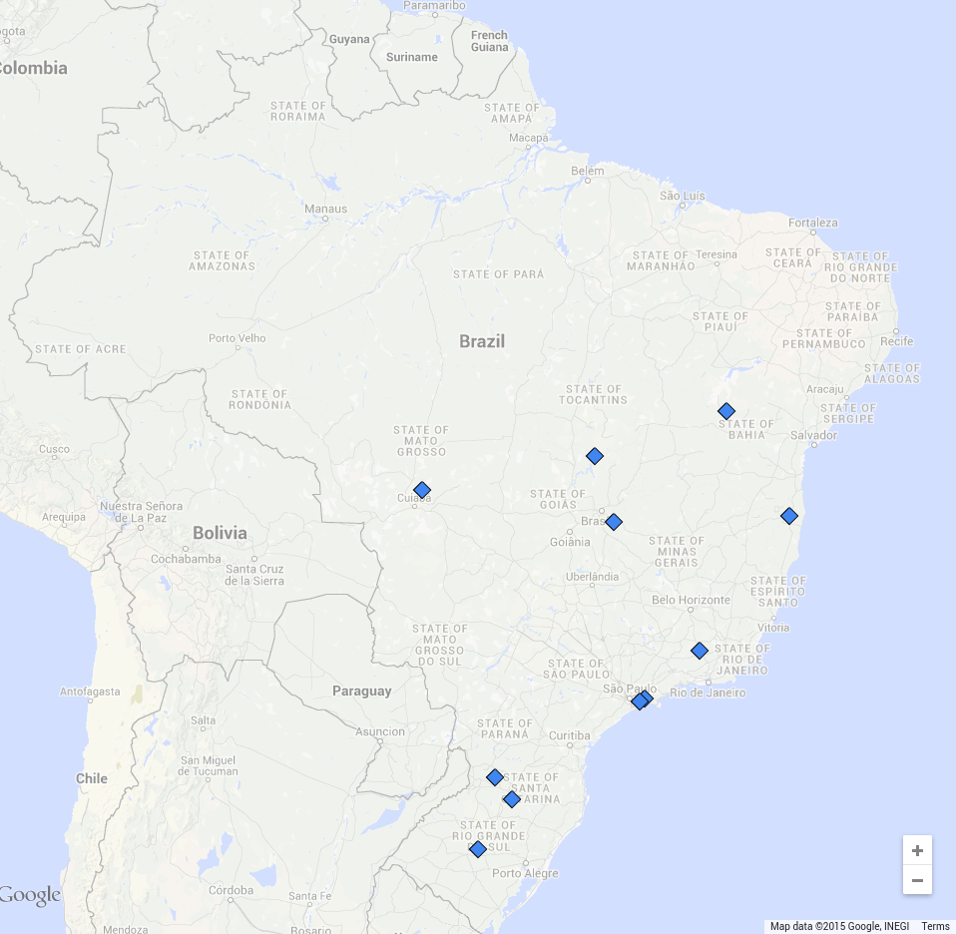
Validating Dam Constructions
Global Reservoir and Dam (GRanD) Database:
An initiative by Global Water System Project (GWSP)
Reports 65 dams globally constructed after 2000
12 new dams in Brazil
UMN Approach:
Finds 134 dam constructions after 2000 in Brazil¹
GRanD (12)
¹Prepared in collaboration with Juan Carlos, Planetary Skin Institute

Slide 22
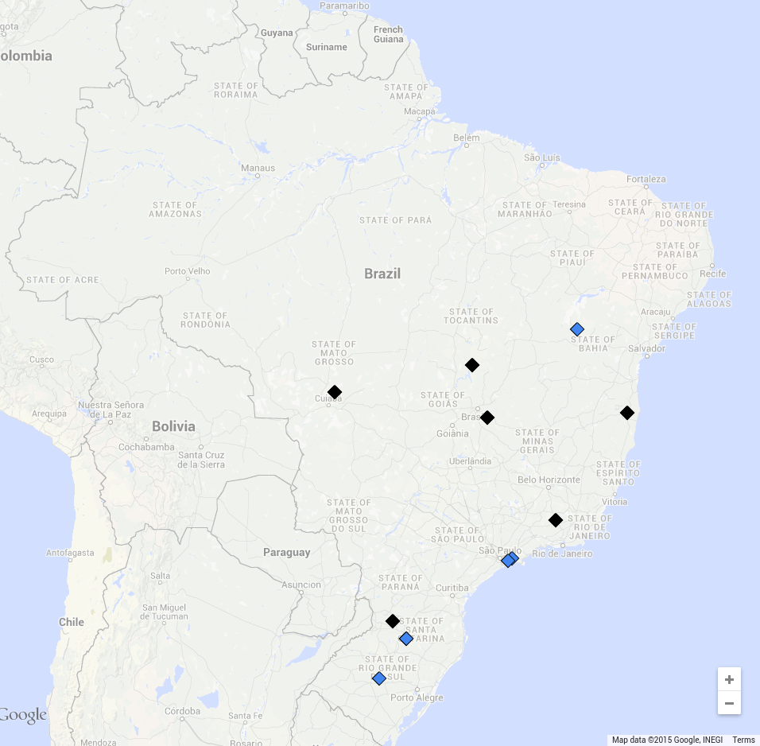
Validating Dam Constructions
Global Reservoir and Dam (GRanD) Database:
An initiative by Global Water System Project (GWSP)
Reports 65 dams globally constructed after 2000
12 new dams in Brazil
UMN Approach:
Finds 134 dam constructions after 2000 in Brazil¹
Only GRanD (5)
GRanD & UMN
(7)
Missing run-of-the-river dams with small water storage ( < 2.5 km²)
¹Prepared in collaboration with Juan Carlos, Planetary Skin Institute

Slide 23
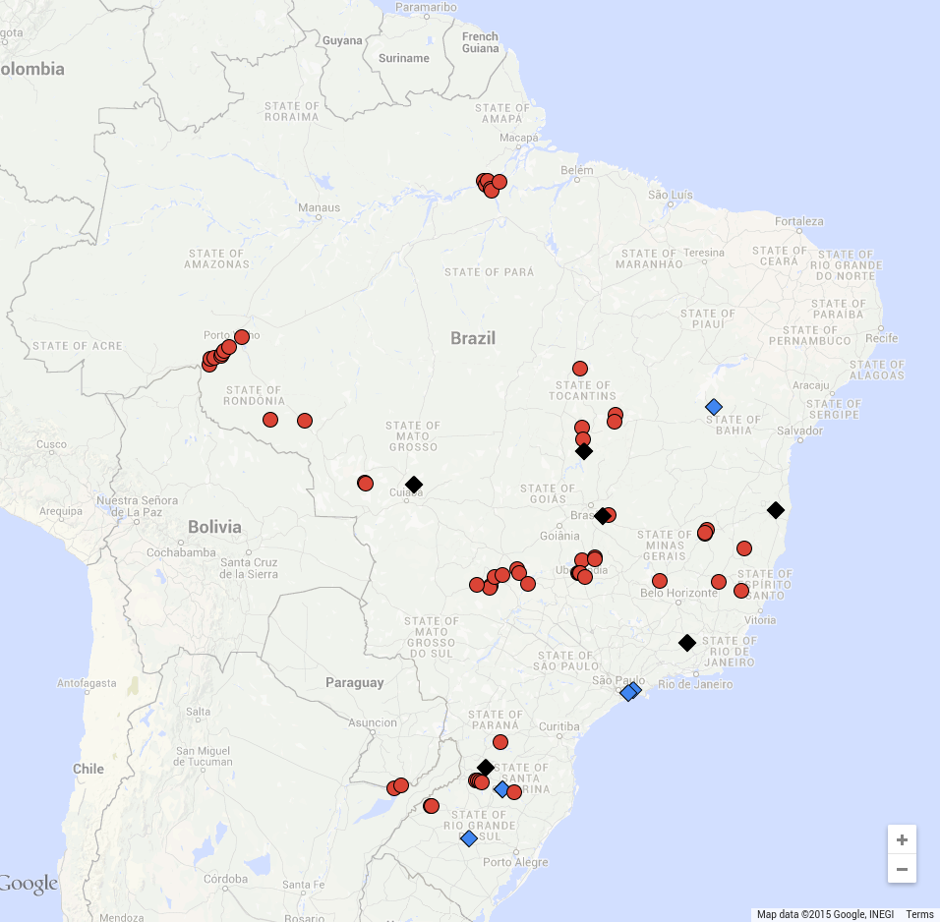
Validating Dam Constructions
Global Reservoir and Dam (GRanD) Database:
An initiative by Global Water System Project (GWSP)
Reports 65 dams globally constructed after 2000
12 new dams in Brazil
UMN Approach:
Finds 134 dam constructions after 2000 in Brazil¹
Only GRanD (5)
GRanD & UMN
(7)
Reported by CBDB
(44)
¹Prepared in collaboration with Juan Carlos, Planetary Skin Institute

Slide 24
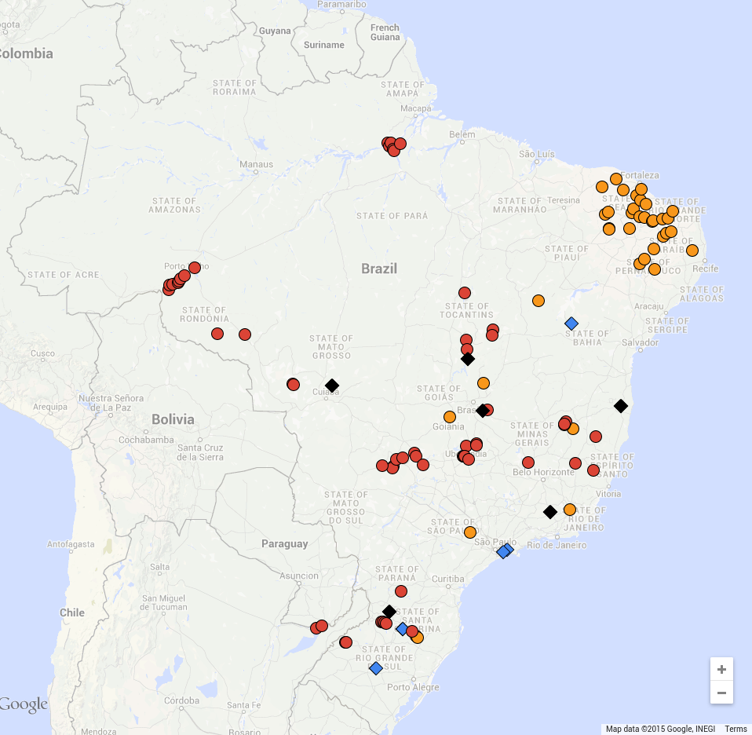
Validating Dam Constructions
Global Reservoir and Dam (GRanD) Database:
An initiative by Global Water System Project (GWSP)
Reports 65 dams globally constructed after 2000
12 new dams in Brazil
UMN Approach:
Finds 134 dam constructions after 2000 in Brazil¹
Only GRanD (5)
GRanD & UMN
(7)
Reported by CBDB
(44)
Agriculture Dams (32)
¹Prepared in collaboration with Juan Carlos, Planetary Skin Institute

Slide 25

Validating Dam Constructions
Global Reservoir and Dam (GRanD) Database:
An initiative by Global Water System Project (GWSP)
Reports 65 dams globally constructed after 2000
12 new dams in Brazil
UMN Approach:
Finds 134 dam constructions after 2000 in Brazil¹
Only GRanD (5)
GRanD & UMN
(7)
Reported by CBDB
(44)
Hydro
Dams (41)
Agriculture Dams (32)
¹Prepared in collaboration with Juan Carlos, Planetary Skin Institute

Slide 26

Validating Dam Constructions
Global Reservoir and Dam (GRanD) Database:
An initiative by Global Water System Project (GWSP)
Reports 65 dams globally constructed after 2000
12 new dams in Brazil
UMN Approach:
Finds 134 dam constructions after 2000 in Brazil¹
Only GRanD (5)
GRanD & UMN
(7)
Mining
(10)
Reported by CBDB
(44)
Hydro
Dams (41)
Agriculture Dams (32)
¹Prepared in collaboration with Juan Carlos, Planetary Skin Institute

Slide 27
Acknowledgments
Team UMN:
  Ankush Khandelwal, Xi Chen, Varun Mithal, Yizheng Ding, Robert Leuenberger, Kenson Cai, Eric Mccaleb, Vipin Kumar
Collaborators:
  Institute on Environment, UMN: Kate Brauman
  Planetary Skin Institute: Juan Carlos Castilla-Rubio, Fabio Faria
Funding:
  National Science Foundation Awards 1029711 and 0905581
  NASA Award NNX12AP37G
  Doctoral Dissertation Fellowship and UMII Informatics Fellowship

Slide 28
Research Questions
What are the types of changes/patterns in surface water dynamics that we can monitor using remote sensing data?
How can we use this system to analyze the impact of human actions (e.g. dam constructions) on water resources?
Can we couple this with surface hydrology models to estimate river flow, discharge volume, etc.?
http://z.umn.edu/monitoringwater

